Slide 1

Machine Learning Model to Predict activity of short antimicrobial Peptides from set of Antimicrobial sets QSAR
By : Kashaf Naz

Slide 2
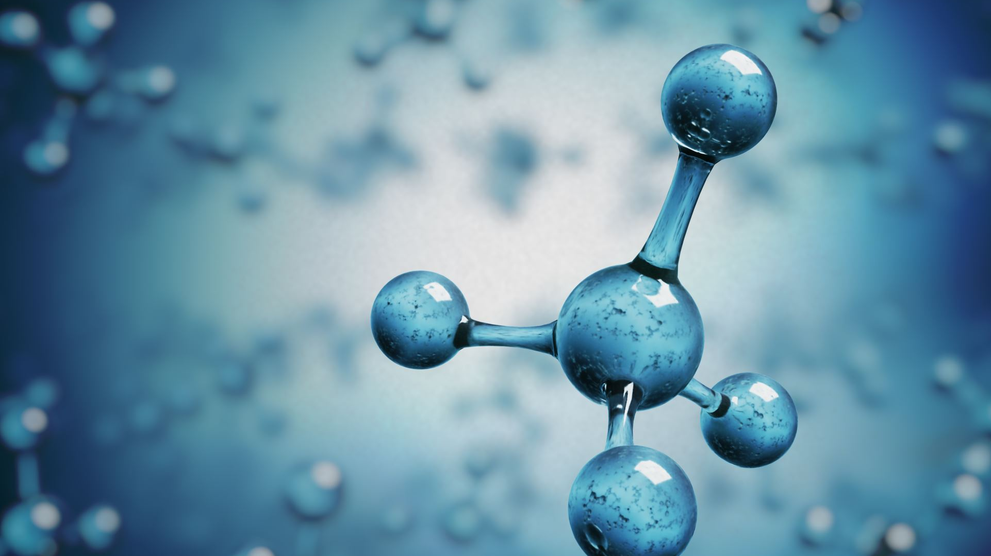
Outline
What is peptides and it's activity
List of libraries I used
Pfeature composition importance in computing AMP
What is Lazypredict
What is Random Forest
Display Dataframe of the dataset after feature selection (variance threshold) - Goal

Slide 3
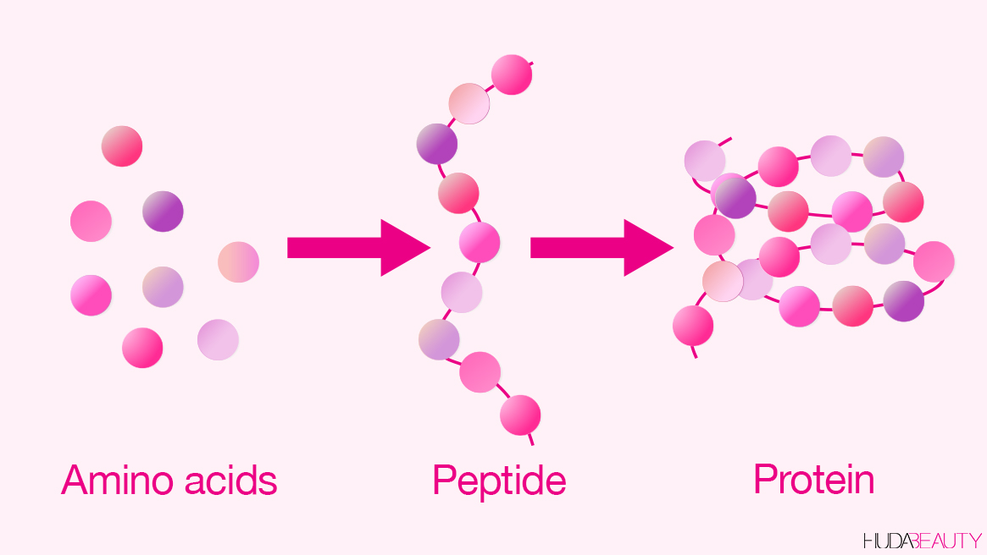
Peptides
Peptides are short chains of between two and fifty amino acids, linked by peptide bonds. Chains of fewer than ten or fifteen amino acids are called oligopeptides, and include dipeptides, tripeptides, and tetrapeptides. A polypeptide is a longer, continuous, unbranched peptide chain of up to approximately fifty amino acids.

Slide 4
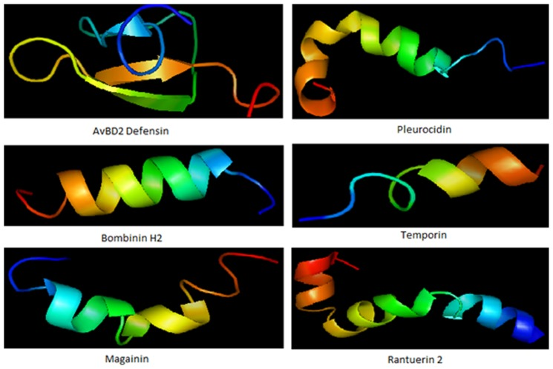
Antimicrobial Peptide
Antimicrobial peptides are a unique and diverse group of molecules, which are divided into subgroups on the basis of their amino acid composition and structure.Antimicrobial peptides are generally between 12 and 50 amino acids.

Slide 5
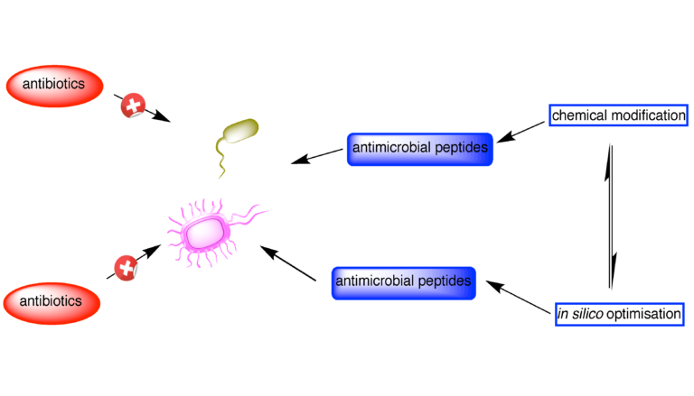
Activity of short Antimicrobial Peptides
Antimicrobial peptides are a unique and diverse group of molecules, which are divided into subgroups on the basis of their amino acid composition and structure. Antimicrobial peptides are generally between 12 and 50 amino acids
Antimicrobial peptides (AMPs) are a class of short, usually positively charged polypeptides that exist in humans, animals, and plants. Considering the increasing number of drug-resistant pathogens, the antimicrobial activity of AMPs has attracted much attention.

Slide 6
Predict activity of short Antimicrobial Peptides We have to Play around with these:
Conda | In which we install packages like python, Our working Environments
Lazypredict | AutoML
Pfeature | Pfeature allow us to compute properties of Amino Acid which will be crucial to Quantify the Molecular properties of peptides
Jupyter NoteBook/ Colab
CD-Hit from bioconda | A library allows us to fit or out any Redundancy in Peptide Sequence, meaning that peptide that are Much Similar will be removed, So We will get non-redundant and a unique sub set of Peptides that will be using in Molecular sequence
Pandas | It’s data-frame for viewing Visualization
Python | For Programing
Random Forest classifier | modeling
Matplotlip | Graph visualization

Slide 7
Pfeature Composition Table
Feature claass | Description | Function
AAC | Amino acid composition | aac_wp
DPC | Dipeptide composition | dpc_wp
TPC | Tripeptide composition | tpc_wp
ABC | Atom and bond composition | atc_wp, btc_wp
PCP | Physico-chemical properties | pcp_wp
AAI | Amino acid index composition | aai_wp
RRI | Repetitive Residue Information | rri_wp
DDR | Distance distribution of residues | ddr_wp

Slide 8
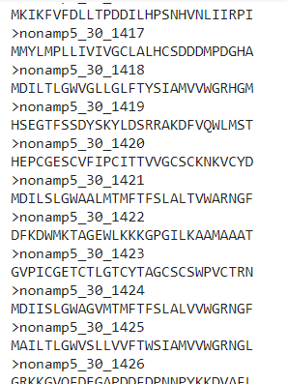
A glance on .Fasta File of AA
In bioinformatics and biochemistry, the FASTA format is a text-based format for representing either nucleotide sequences or amino acid (protein) sequences, in which nucleotides or amino acids are represented using single-letter codes. The format also allows for sequence names and comments to precede the sequences.

Slide 9
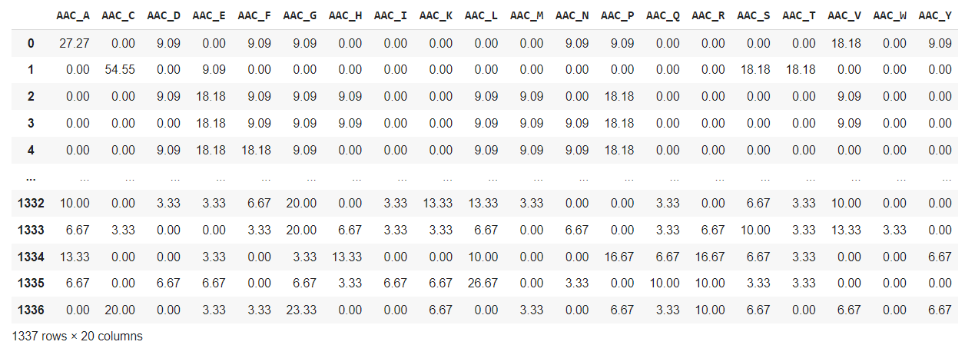
Define functions for calculating the different features
Amino acid composition (AAC)
from Pfeature.pfeature import aac_wp

Slide 10
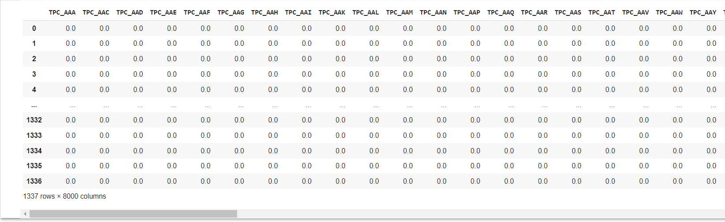
Define functions for calculating the different features
tripeptide composition (TPC)
from Pfeature.pfeature import tpc_wp

Slide 11
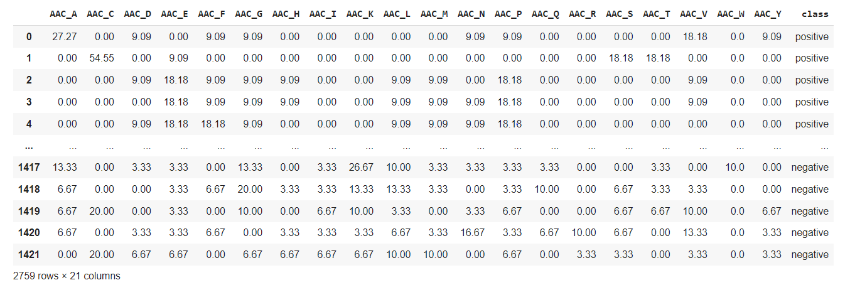
Calculate feature for both positive and negative classes + combines the two classes + merge with class labels
pos = 'train_po_cdhit.txt'
neg = 'train_ne_cdhit.txt'
feature = feature_calc(pos, neg, aac) # AAC

Slide 12
Tripeptide composition (TPC)
pos = 'train_po_cdhit.txt'
neg = 'train_ne_cdhit.txt'
feature = feature_calc(pos, neg, aac) # TPC

Slide 13
Quickly compare >30 ML algorithms

Slide 14
Lazypredict- The Automl library
Lazy Predict Helps build a lot of basic models without much code and helps understand which models works better without any parameter tuning.
There are two classes, LazyClassifier and LazyRegressor, respectively for classifier and regressor. We can import the classifier class if your problem is classification, and import regressor if you have a regression problem.
Data split
X_train, X_test, y_train, y_test = train_test_split(X, y, test_size=0.2, random_state =42, stratify=y)
Defines and builds the lazyclassifier
clf = LazyClassifier(verbose=0,ignore_warnings=True, custom_metric=matthews_corrcoef)
models_train,predictions_train = clf.fit(X_train, X_train, y_train, y_train)
#models_test,predictions_test = clf.fit(X_train, X_test, y_train, y_test)

Slide 15
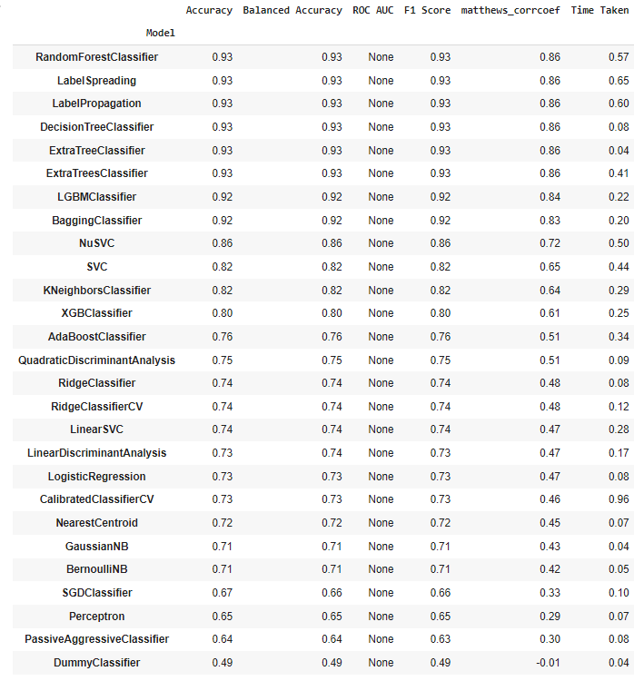
Prints the model performance (Training set)
models_train

Slide 16
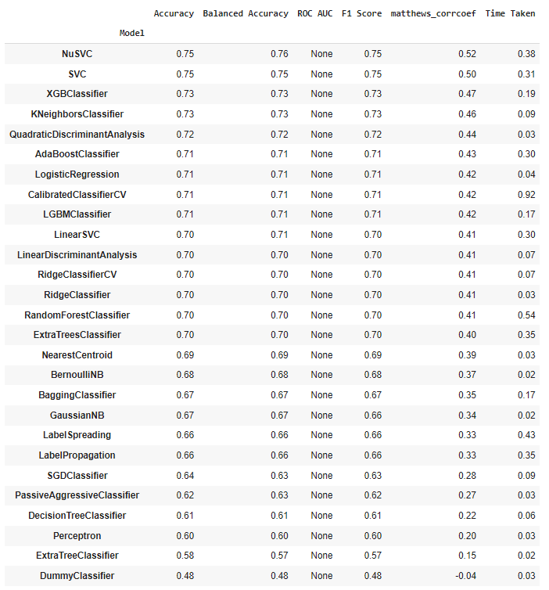
Prints the model performance (Test set)
models_test

Slide 17
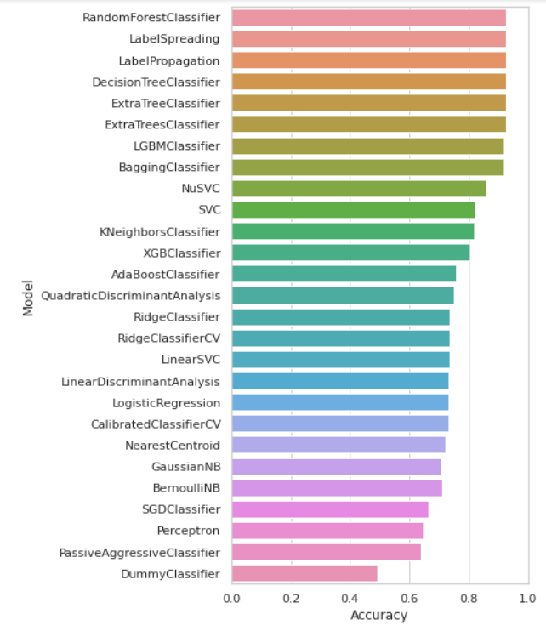
Plot of Accuracy

Slide 18
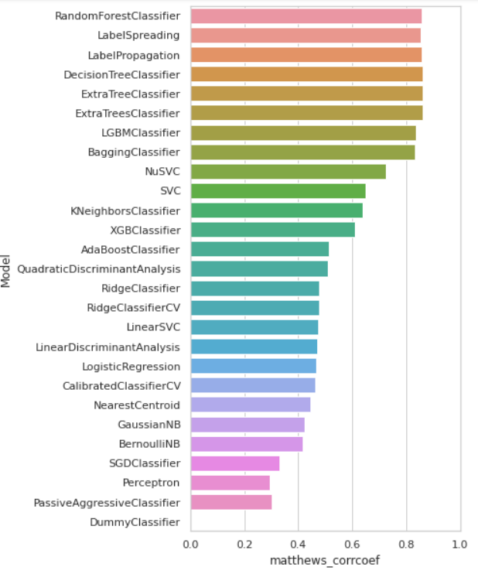
Plot of MCC

Slide 19
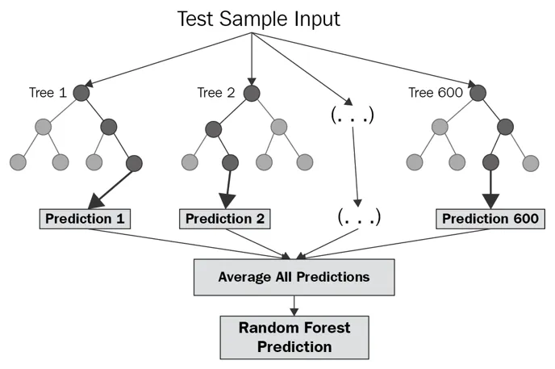
What is Random Forest?
Random forest is a technique used in modeling predictions and behavior analysis and is built on decision trees. It contains many decision trees representing a distinct instance of the classification of data input into the random forest. The random forest technique considers the instances individually, taking the one with the majority of votes as the selected prediction.
The random forest technique can handle large data sets due to its capability to work with many variables running to thousands.

Slide 20
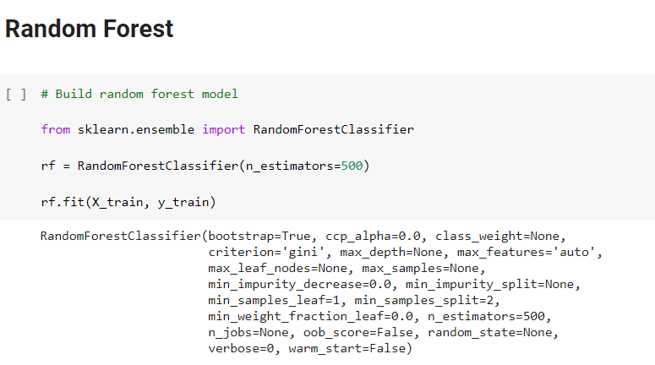

Slide 21
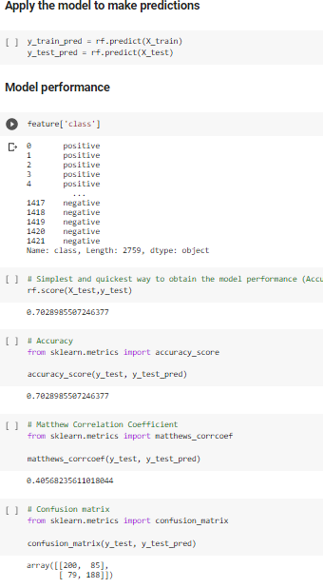
Build random forest model

Slide 22
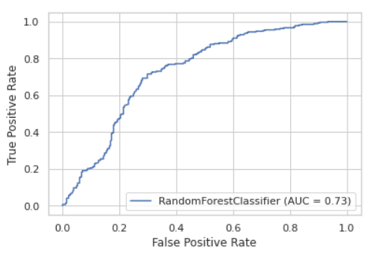
Receiver operating characteristic(ROC) curve

Slide 23
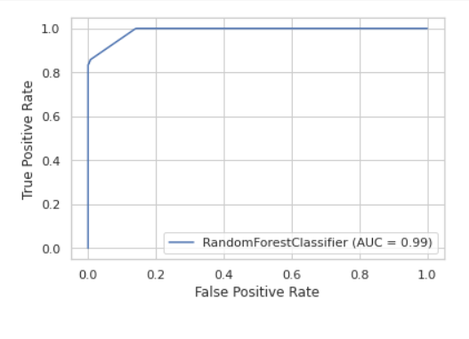
Receiver operating characteristic(ROC)curve

Slide 24
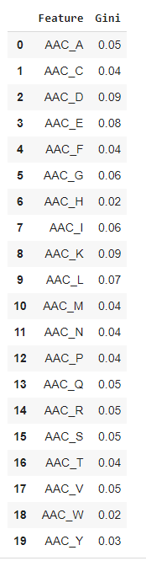
Combine feature names and Gini values into a Dataframe

Slide 25
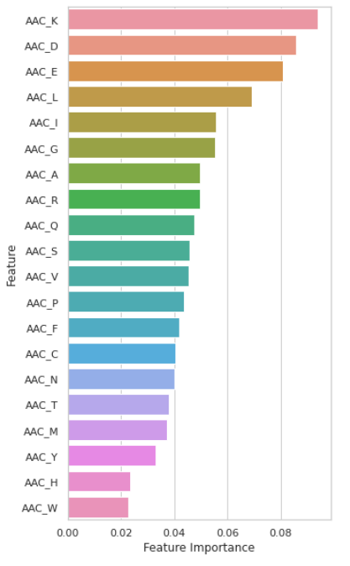
Plot of feature importance
Sort by Gini in descending order

Slide 26
Thank You

